Slide 1
Programming Model and Synthesis for Low-power Spatial Architectures
Phitchaya Mangpo Phothilimthana
Nishant Totla
University of California, Berkeley
Notes:
Introduce a little slowly and better.

Slide 2
Heterogeneity is Inevitable
Why heterogeneous system/architecture?
Energy efficiency
Runtime performance
What is the future architecture? Convergence point unclear. But it will be some combination of
Many small cores (less control overhead, smaller bitwidth)
Simple interconnect (reduce communication energy)
New ISAs (specialized, more compact encoding)
What we are working on
Programming model for future heterogeneous architectures
Synthesis-aided “compiler”
We want both!
Notes:
Intro: Heterogeneous architectures are the future, because they help us achieve both energy efficiency and runtime performance using multiple specialized cores.
Many of today’s popular architectures are powerful, but not really tuned to be extremely energy efficient. For examples, we have amazing smartphones today, but their batteries don’t usually last more than a day.
To achieve the goal of energy efficiency, future architectures will have to become simpler and minimal.
They will have features like multiple small cores, simple interconnects between these cores, and new Instruction Set Architectures.
But we pay a price for this – the gap between hardware and software gets bigger, and it becomes harder to write programs for them.
We do not build architectures, and cannot predict what the future will look like. BUT, we are building a programming model and versatile synthesis-based compiler toolchain for future heterogeneous architectures.
Our system would allow both architecture specialists to push the hardware to extremes, and programmers to program without worrying about low-level details.

Slide 3
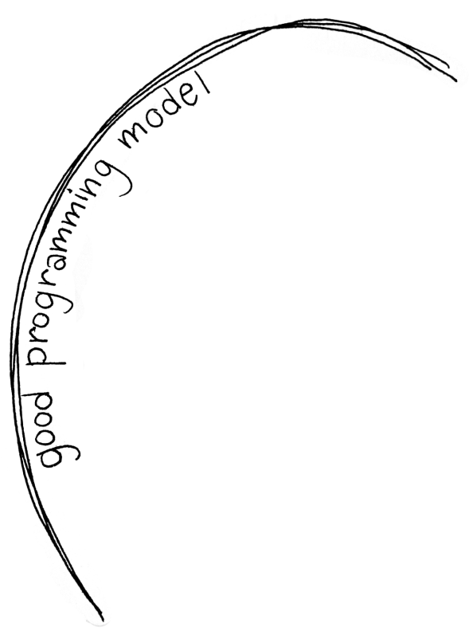




Energy Efficiency vs. Programmability
“The biggest challenge with 1000 core chips will be programming them.”¹
- William Dally (NVIDIA, Stanford)
On NVIDIA’s 28nm chips, getting data from neighboring memory takes 26x the energy of addition.¹
Cache hit uses up to 7x energy of addition.²
Future architectures
Challenges
Many small cores
Fine-grained partitioning
New ISAs
New compiler optimizations
Simple interconnect
SW-controlled messages
1: http://techtalks.tv/talks/54110/
2: http://cva.stanford.edu/publications/2010/jbalfour-thesis.pdf
Notes:
Intro: Today’s hardware has many programmer friendly constructs that reduce energy efficiency.
Future architectures will change that, but there will be challenges. Code will have to be partitioned, new compilers will have to be written, and the hardware may not implement communication.
This puts a lot of pressure on the programmer, reducing the usability of these architectures. Hence, it is important to have a good programming model that separates the extremities of the hardware from the programmer.
Prof. William Dally of Stanford, also Chief Scientist at nVIDIA has said that the biggest challenge with multicore chips will be programming them. This is especially important, because caching and communication are expensive, and the programming model must intelligently handle this.
----- Meeting Notes (3/14/13 17:21) -----
Get the date on Dally's quote. Say "recent quote"
Also slow down with the animations

Slide 4
Compilers: State of the Art
Brand new compiler
Takes 10 years to build an optimizing compiler
New hardware
Modify existing compiler
Stuck with similar architecture
Synthesis
(our approach)
Break free from the architecture
If you limit yourself to a traditional compilation framework, you are restricted to similar architectures or have to wait for years to prove success.
Synthesis, an alternative to compilation
Compiler: transforms the source code
Synthesis: searches for a correct, fast program
Notes:
Intro: So what’s wrong with existing compilers?
Suppose Qualcomm want to come up with a new hardware that is drastically different from what exists now, how would they program it?
They could get a new compiler, but we know that is a long process.
They could modify an existing compiler, but that essentially means the hardware cannot be too different from the existing one.
The bottom line is, that with today’s compiler technology, you either have to restrict yourself, or wait for a long time to achieve success.
This is why we use synthesis, which is an alternative to compilation.
Compilers transform source code through various steps into machine code, whereas synthesis is a search for an efficient, correct program in a space that the programmer specifies.
Synthesis is versatile, because the space of correct programs is specified independent of the low-level hardware.
Transition: Let’s see what synthesis is.
----- Meeting Notes (3/14/13 17:21) -----
What do you mean by similar looking architectures? Be careful here. Maybe say „architectures with similar structure or ISAs”

Slide 5
Program Synthesis (Example)
Specification:
int[16] transpose(int[16] M) {
int[16] T = 0;
for (int i = 0; i < 4; i++)
for (int j = 0; j < 4; j++)
T[4 * i + j] = M[4 * j + i];
return T;
}
int[16] trans_sse(int[16] M) implements trans { // synthesized code
S[4::4] = shufps(M[6::4], M[2::4], 11001000b);
S[0::4] = shufps(M[11::4], M[6::4], 10010110b);
S[12::4] = shufps(M[0::4], M[2::4], 10001101b);
S[8::4] = shufps(M[8::4], M[12::4], 11010111b);
T[4::4] = shufps(S[11::4], S[1::4], 10111100b);
T[12::4] = shufps(S[3::4], S[8::4], 11000011b);
T[8::4] = shufps(S[4::4], S[9::4], 11100010b);
T[0::4] = shufps(S[12::4], S[0::4], 10110100b);
return T;
}
x1
x2
imm8[0:1]
return
Sketch:
Synthesized program:
int[16] trans_sse(int[16] M) implements trans {
int[16] S = 0, T = 0;
repeat (??) S[??::4] = shufps(M[??::4], M[??::4], ??);
repeat (??) T[??::4] = shufps(S[??::4], S[??::4], ??);
return T;
}
Synthesis time < 10 seconds.
Search space > 10⁷⁰
Notes:
Intro: Here is an interesting example of how synthesis can find an optimal program that is hard to find manually.
Here is a simple code written in C to transpose a matrix. Using the shufps instruction, which shuffles two bitvectors to create a new one, transpose can be optimized.
But how to do it? For an expert (grad student), doing it manually took many days of effort.
To do it with synthesis, the programmer just specifies this skeleton program, which is simply a high level intuition of the algorithm. In this case, the intuition simply is that the transpose can be obtained through a series of shuffles. But how many? Which ones exactly? The programmer need not bother about all those details.
Here’s the synthesized program. It takes less than 10 seconds to synthesize, for a really large search space.
Leo Meyerovich and Seth Fowler, who were recipients of the first Qualcomm Fellowship, used program synthesis for their parallel browser project.
In some cases, the programmer need not specify the sketch, and the program can be generated without a sketch. This technique is called superoptimization.
----- Meeting Notes (3/14/13 17:21) -----
The human expert : someone in the past took so and so much time. Some domain expert.
Shorten. Just say that here's an example that shows the power of synthesis.

Slide 6
Our Plan
New Programming Model
High-Level Program
Partitioner
Per-core High-Level Programs
New Approach
Using
Synthesis
Code Generator
Per-core Optimized Machine Code
Notes:
Intro: With that background, here’s an overview of our project.
The programmer programs the hardware using a C-like high-level program.
Our code partitioner partitions the program into smaller high-level programs.
The code generator then converts these high-level programs to optimized machine code.
The initial program is written in our programming model, while the partitioning and code generation use synthesis.
Transition: Now, Mangpo will explain in detail how our tool works.
----- Meeting Notes (3/14/13 17:21) -----
People might not get what this slide actually is talking about. Intro that this is about multicore architectures.
Also, some way to tie this to previous slides. Too much transition.

Slide 7
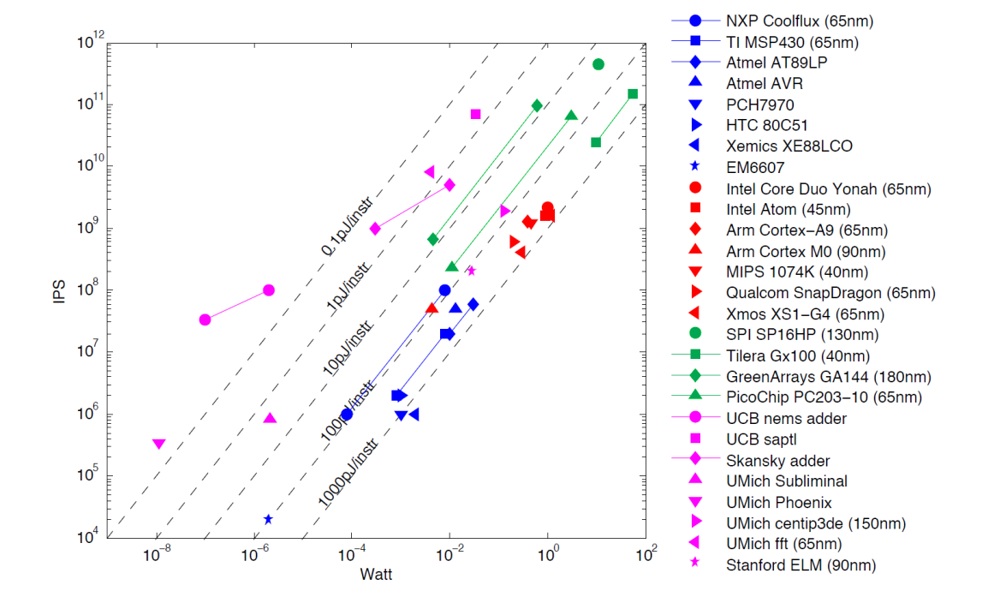
Case study: GreenArrays Spatial Processors
# of Instructions/second vs Power
Specs
Stack-based 18-bit architecture
32 instructions
8 x 18 array of asynchronous computers (cores)
No shared resources (i.e. clock, cache, memory). Very scalable architecture.
Limited communication, neighbors only
< 300 byte memory per core
~100x
Example challenges of programming spatial architectures like GA144:
Bitwidth slicing: Represent 32-bit numbers by two 18-bit words
Function partitioning: Break functions into a pipeline with just a few operations per core.
Figure from Per Ljung
Finite Impulse Response Benchmark
GA144 is 11x faster and simultaneously 9x more energy efficient than MSP 430.
Data from Rimas Avizienis
Notes:
Intro sentence: Of course, it is almost impossible to build our tool from non-existing future architecture. Therefore, we pick GA as our case-study because it is an extreme case of what the future arch might look like. We believe that if we can support this hardware, we can also support other hardware.
Sequence of talking points:
GA has many really tiny cores, only 32 machine instructions, and simple inter-connect.
no shared memory, no cache, or even a clock
More uniquely, it is a stack-based 18-bit arch.
If we look at the average energy usage per inst, the main stream risc arch such as ARM and qualcomm is 100x less energy eff.
In an actual application, FIR (full)
However, it is extremely difficult to program on GA. Imagine you have to use multiple words to represent a number. A function cannot fit in one core, so you need to partition it.
Yet you can implement non-trivail application on GA such as MD5 hash function.
----- Meeting Notes (3/14/13 17:21) -----
Skip specs and energy efficiency. Say that "here's an architecture that we can evaluate on"
And here are some of the explicit challanges in the model. Here are the challenges. Say that human will find it hard. Focus on the important points.
Say that "this is interesting because it is an extreme highlight point"
Highlight just the important details.
On the graph, data points are not visible and misunderstood. Point to those clearly.

Slide 8
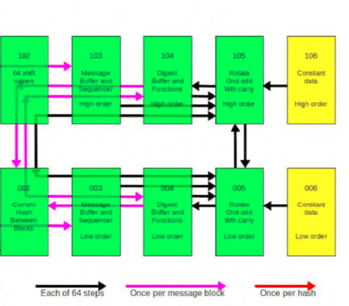
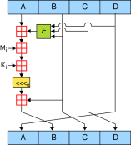


Spatial programming model
102
103
104
105
106
Shift
value R
message M
rotate &
add with carry
constant K
002
003
004
005
006
current hash
message M
rotate &
add with carry
constant K
typedef pair<int,int> myInt;
vector<myInt>@{[0:64]=(106,6)} k[64];
myInt@(105,5) sumrotate(myInt@(104,4) buffer, ...) {
myInt@here sum = buffer +@here k[i] + message[g];
...
}
typedef pair<int,int> myInt;
vector<myInt>@{[0:64]=(106,6)} k[64];
myInt@(105,5) sumrotate(myInt@(104,4) buffer, ...) {
myInt@here sum = buffer +@here k[i] + message[g];
...
}
typedef pair<int,int> myInt;
vector<myInt>@{[0:64]=(106,6)} k[64];
myInt@(105,5) sumrotate(myInt@(104,4) buffer, ...) {
myInt@here sum = buffer +@here k[i] + message[g];
...
}
typedef pair<int,int> myInt;
vector<myInt>@{[0:64]=(106,6)} k[64];
myInt@(105,5) sumrotate(myInt@(104,4) buffer, ...) {
myInt@here sum = buffer +@here k[i] + message[g];
...
}
typedef pair<int,int> myInt;
vector<myInt>@{[0:64]=(106,6)} k[64];
myInt@(105,5) sumrotate(myInt@(104,4) buffer, ...) {
myInt@here sum = buffer +@here k[i] + message[g];
...
}
typedef pair<int,int> myInt;
vector<myInt>@{[0:64]=(106,6)} k[64];
myInt@(105,5) sumrotate(myInt@(104,4) buffer, ...) {
myInt@here sum = buffer +@here k[i] + message[g];
...
}
typedef pair<int,int> myInt;
vector<myInt>@{[0:64]=(106,6)} k[64];
myInt@(105,5) sumrotate(myInt@(104,4) buffer, ...) {
myInt@here sum = buffer +@here k[i] +@?? message[g];
...
}
k[i] is at (106,6)
buffer is at (104,4)
+ is at (105,5)
buffer is at (104,4)
+ is at (105,5)
k[i] is at (106,6)
106
104
106
104
105
105
high order
high order
high order
+
high order
+
buffer
buffer
k[i]
k[i]
6
4
6
4
5
5
+
+
low order
low order
low order
low order
Notes:
According to the GA documentation, example MD5 code is implemented on 10 cores, so programmers have to deal with partitioning, explicit comm. Furthermore, in each core, they have to write assembly-like program that also stack-based.
Of course, no one wants to deal with these low-level details.
The existing programing models for heterogeneous system don’t support such fine-grained partitioning but ours does and at the same time hides all the low-level detail implementation.
Here is the snippet of a fragment of MD5 code in our language. It looks just a C function. Notice we represent 32-bit int (myInt) with 2 pairs of 18-bit int because GA only 18-bit numbers. (use laser to point)
Our language extension allows programmer to specify placement of data and operation by using annotation.
One way to deal with array of 32-bit number is to place the high order bits of the array on one core, and low order bits on another. And here is the placement of other variable and operation in the code.
If we look at the big picture, there is communication, but we don’t have to handle it explicitly.
If we don’t know the placement of something, we have an option to leave it unspecified like the red +.
Transition sentence: And here is where our synthesis technology comes in
----- Meeting Notes (3/14/13 17:21) -----
Too much stuff on the slides! Might have to skip details.

Slide 9




Optimal Partitions from Our Synthesizer
Benchmark: simplified MD5 (one iteration)
Partitions are automatically generated.
256-byte mem per core
initial data placement specified
102
103
F
high
104
105
106
R_{i}
R
M
<<<
K
2
3
F
4
5
6
low
M
<<<
K
512-byte mem per core
different
initial data placement
512-byte mem per core
same initial data placement
F
202
F
102
103
104
105
106
high
<<<
R
M
K
102
103
106
<<<
2
3
F
5
R
M
K
4
6
low
M
K
Notes:
We run a simplified MD5 with one iteration through our current partitioning synthesizer. This fist example specifies the initial data placement, our partitioner automatically outputs the best mapping of computation on cores such that it minimizes # of msgs passing between cores.
If we change the architecture by doubling the core size. The best placement assignment is changed. Notice that we can fit more computation on each core.
With same arch, but init placement is changed, best mapping is also changed.
The point I want to make is that our system is easily retargetable across different architectures.
Transition: let’s now move on to the back end of our tool
----- Meeting Notes (3/14/13 17:21) -----
Can steal some time here!

Slide 10
Retargetable Code Generation
Traditional compiler needs many tasks:
implement optimizing transformations,
including hardware-specific code generation (e.g. register allocation, instruction scheduling)
Synthesis-based code translation needs only these:
define space of programs to search, via code templates
define machine instructions, as if writing an interpreter
Partitioner
Code Generator
Example: define exclusive-or for a stack architecture
xor = lambda: push(pop() ^ pop())
Synthesizer can generate code from
a template with holes as in transpose example --> sketching
an unconstrained template --> superoptimization
Notes:
Intro: we already mention that traditional compiler cannot foster the radical changes in hardware design because it takes years and years to build an optimizing compiler that is specific to the hardware.
In synthesis-based code generation, we only need to define space of programs to search and define machine instructions as easy as if we write an intepreter.
For example, if we want to define an xor for stack-based hardware, we on need to say that: pop 2 elements from the stack. Xor them together, and push the result back to the stack.
Our synthesizer can generate code from a template with holes by sketching; or generate code from an empty template by superoptimization
----- Meeting Notes (3/14/13 17:21) -----
Synthesis only needs lightweight specifications of new instructions, and that would be enough

Slide 11
Code Generation via Superoptimization
Current prototype synthesizes a program with
8 unknown instructions in 2 to 30 seconds
~25 unknown instructions within 5 hours
Synthesized functions are
1.7x – 5.2x faster and 1.8x – 4x shorter than naïve implementation of simple GreenArrays functions
1.1x-1.4x faster and 1.5x shorter than optimized hand-written GreenArrays functions by experts (MD5 App Note)
Program | Solution
x/3 | (43691 * x) >> 17
x/5 | (52429* x) >> 18
x/6 | (43691 * x) >> 18
x/7 | (149797 * x) >> 20
Synthesize efficient division by constant
quotient = (?? * n) >> ??
Notes:
Our current superoptimizer synthesizes small program within 30 s and larger programs in 5 hours.
You might think 5 hours sounds bad, but if you have experience programming on FPGA, its compiler takes hours to compile code. Also, consider this real scenario. The GA expert spent a week to write well-optimized program, our synthesizer found 1.5x faster and shorter program within 5 hours. And up to 5x faster and shorter programs compared with naive implementations.
The synthesizer can also generate code from a sketch with holes.
In this example, we synthesize integer division. GA doesn’t have division instruction, but we can give our insight to the synthesizer that the quotient is equal to this expression, but we don’t know what the constants are. This table shows the constants generated by the synthesizer when we synthesize division by different divisors.

Slide 12
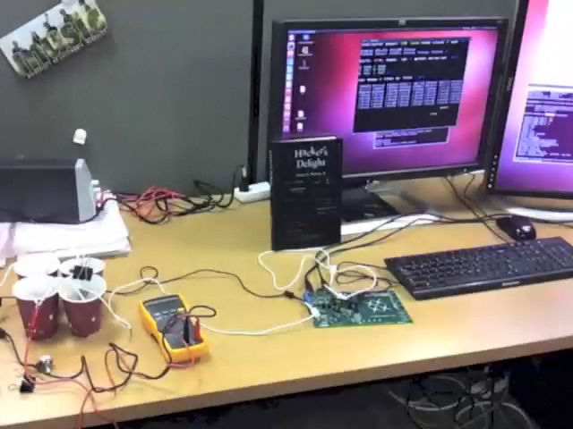
Demo and Future
Current Status
Partitioner for straight-line code
Superoptimizer for smaller code
Future Work
Make synthesizer retargetable
Release it!
Design spatial data structures
Build low-power gadgets for audio, vision, health, …
We will answer
“how minimal can hardware be?”
“how to build tools for it?”
Blinking LED
Input here
Notes:
Here is the demo of the program we synthesize: divide by 5 on GA
We are gonna continue improving our partioner and superoptimizer.
Make our tool retargetable. Release it.
Implement a library for spatial datat structures.
Build cool gadgets of practical applications on real low-power hardware.
Conclusion: Ultimately, we will answer how minimal hardware can be to achieve the most energy efficiency, and how we can build programming tool for it.
----- Meeting Notes (3/14/13 17:21) -----
Just summarize video and skip it in case we're running short on time.
----- Meeting Notes (3/14/13 17:26) -----
Emphasize that retargetable means other drastically different architectures.
Also we intend to implement for straight line code

